Slide 1


SURESH ANGADI EDUCATION FOUNDATION’S
ANGADI INSTITUTE OF TECHNOLOGY AND MANAGEMENT
Savagaon Road, BELAGAVI – 590 009.
(Approved by AICTE, New Delhi & Affiliated to Visvesvaraya Technological University, Belagavi,
Accredited by NAAC & *NBA)
PRESENTATION ON :
“Smart Blind Stick: Enhancing Mobility for the Visually Impaired”
PRESENTED BY:
Ms. Tejaswini P Allagi
Ms. Namrata J
Ms. Surekha Hachdada
Mr. Viresh M
Ms. Laxmi
Mr. Pavan Badiger
GUIDED BY:
PROF. PRAGATI D HONAGEKAR

Slide 2
INDEX:
Introduction
Problem Statement
Objectives
Literature Survey
5.1 Arduino-based Smart Blind Stick (2023)
5.2 Advanced Smart Blind Stick with GPS & GSM (2024)
System Requirements
6.1 Software Requirements
6.2 Hardware Requirements
Components Used
Microcontroller (Arduino Nano)
Sensors (Ultrasonic, Water, GPS)
Communication Module (GSM)
Output Devices (Buzzer, Display)
Power Supply
Working Principle / System Operation
Conclusion

Slide 3
INTRODUCTION
The Smart Blind Stick is an assistive engineering device developed to enhance the mobility and safety of visually impaired individuals. The system is designed using embedded technology, integrating components such as ultrasonic sensors, a microcontroller, and feedback modules like buzzers or vibration motors. It detects obstacles in the user’s path and provides real-time alerts, enabling safer navigation.
This project combines principles from electronics, programming, and human-centered engineering design to address real-world accessibility challenges. The Smart Blind Stick aims to improve independence, reduce accident risks, and demonstrate the application of modern technology in assistive solutions.

Slide 4
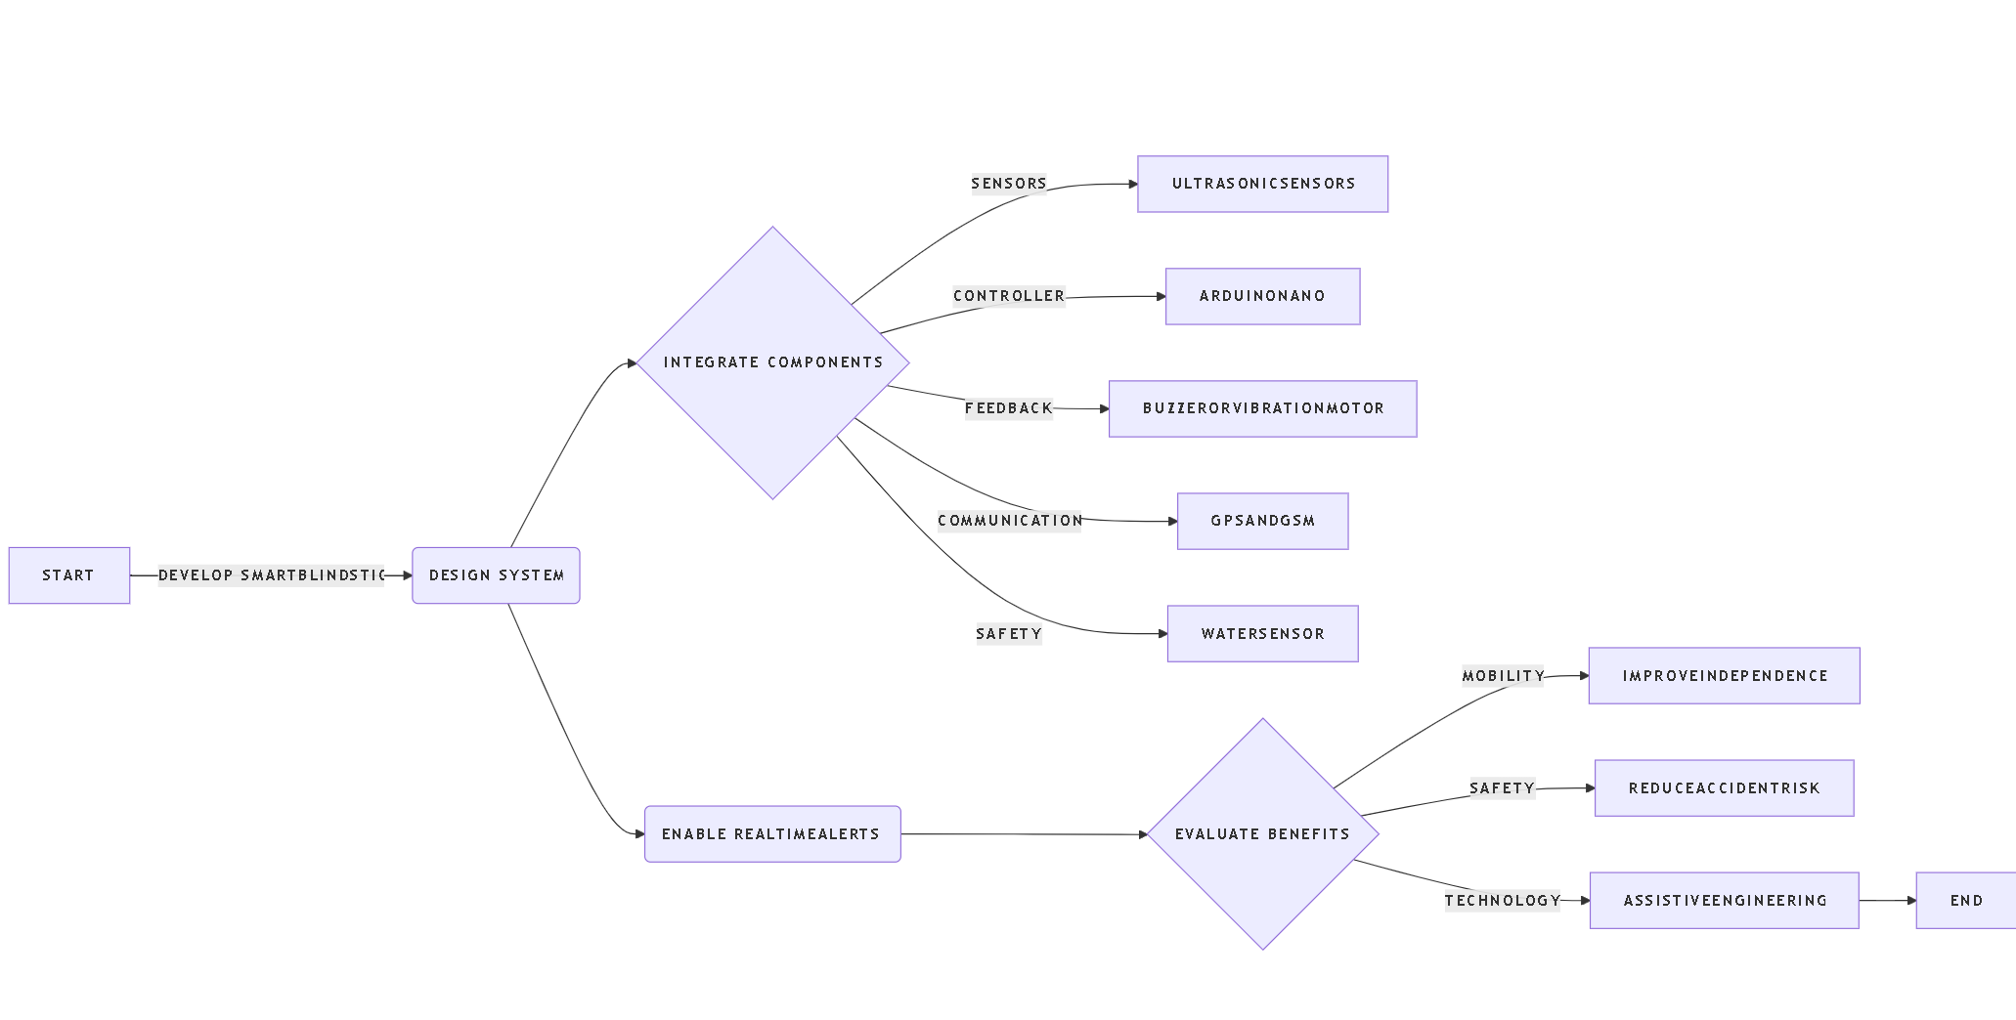
FLOW - CHART

Slide 5
PROBLEM STATEMENT
Visually impaired individuals face significant challenges in navigating their surroundings safely due to the inability to detect obstacles, uneven surfaces, and environmental hazards. Traditional white canes provide limited assistance as they only detect obstacles within a short range and require constant physical contact. This limitation increases the risk of accidents, reduces mobility, and affects the independence of visually challenged individuals.
Therefore, there is a need to develop an intelligent, cost-effective, and user-friendly assistive device that can detect obstacles in real time and provide immediate feedback to the user. The proposed Smart Blind Stick aims to address these challenges by integrating sensor-based technology to enhance safety, mobility, and independence.

Slide 6
OBJECTIVES :
Obstacle Detection: Ultrasonic sensors continuously monitor the surroundings to detect obstacles in real time, ensuring safer navigation for visually impaired users.
Real-Time Feedback: The system provides instant alerts through vibration motors or buzzers, allowing users to respond quickly to nearby hazards.
Smart Navigation Assistance: The device enhances spatial awareness by identifying object distance and direction, helping users move confidently and independently.
User-Friendly Design: The stick is designed to be lightweight, portable, and easy to operate, ensuring comfort and accessibility for daily use.
Cost-Effective Solution: The project focuses on using affordable components to develop an efficient assistive device that is accessible to a wider population.

Slide 7
LITERATURE SURVEY:
Title: Arduino based Smart Blind Stick for People with Vision Loss.
Author: P. Rajesh, R. Sairam, M. Dinesh Kumar, P. Kasi Eswar, Y. Keerthi.
Journal: 2023 7th International Conference on Computing Methodologies and Communication (ICCMC).
Year: 2023
Core Processing Unit: The Arduino microcontroller serves as the brain of the system, processing input signals from sensors and controlling output devices efficiently.
Obstacle Detection System: Ultrasonic sensors are used to measure the distance of obstacles using echo signals, enabling early detection.
Alert Mechanism: A buzzer or vibration motor provides immediate feedback to the user upon detecting obstacles in the path.
Power Management: A battery-powered system ensures portability and continuous operation of the device in real-time conditions.
User Interaction: Simple switches and controls make the device easy to operate without complexity.
System Operation: The sensor detects obstacles → data is processed by Arduino → alert is generated to guide the user safely.

Slide 8
Title: A Remarkable Innovation Empowering the Visually Impaired: The Smart Blind Stick for Independent Navigation
Author: Lalitha Bhavani Konkyana, P.Sirish Kumar, Nelapati Ananda Rao.
Journal: 2024 2nd International Conference on Recent Trends in Microelectronics, Automation, Computing and Communications Systems (ICMACC).
Advanced Sensor Integration for Obstacle Detection The HC-SR04 Ultrasonic Sensor detects obstacles within 2cm to 400cm with 3mm accuracy. It emits 40 kHz pulses and calculates distance based on signal return time. This ensures early obstacle warnings, helping users avoid collisions effectively.
GPS and GSM for Real-Time Location Tracking GPS and GSM modules provide accurate, real-time positioning for the user. The system can transmit the user's location to emergency contacts when needed. This allows confident navigation in unfamiliar environments with enhanced safety.
Arduino Nano as the Central Processing Unit The Arduino Nano processes data from all sensors in real time and triggers buzzer alerts when obstacles are detected. Its compact size allows seamless integration of multiple components into one lightweight device. It serves as the core decision-making unit of the entire system.
Water Sensor and Remote Localization Feature A water sensor detects wet surfaces and alerts the user through the buzzer to prevent falls. A remote-control feature helps users locate the stick via auditory signals. Together, these features make the stick a comprehensive and user-friendly assistive tool.

Slide 9
SYSTEM REQUIREMENTS
1. Development Environment
Arduino IDE (version 1.8 or above)
Blynk Application (iOS / Android)
2. Programming Language
Embedded C / C++ for Arduino
3. Libraries Required
NewSoftSerial / SoftwareSerial Library
TinyGPS++ Library (for GPS parsing)
Blynk Library (for smartphone integration)
4. Operating System (Development Machine)
Windows 7/10/11, macOS, or Linux
Minimum 4GB RAM, 500MB free storage

Slide 10
1. Microcontroller
Arduino Nano (ATmega328P based)
Minimum 32KB Flash Memory
Operating Voltage: 5V
2. Sensors
HC-SR04 Ultrasonic Sensor (range: 2cm – 400cm)
Water/Rain Sensor Module
GPS Module (NEO-6M recommended)
3. Communication Module
GSM Module (SIM800L or equivalent)
SIM card with active network connection
4. Output Components
Buzzer (Active or Passive)
Small Display Screen (optional, for distance readings)
5. Power Supply
9V Battery or Rechargeable Li-ion Battery
USB connection for programming via computer

Slide 11
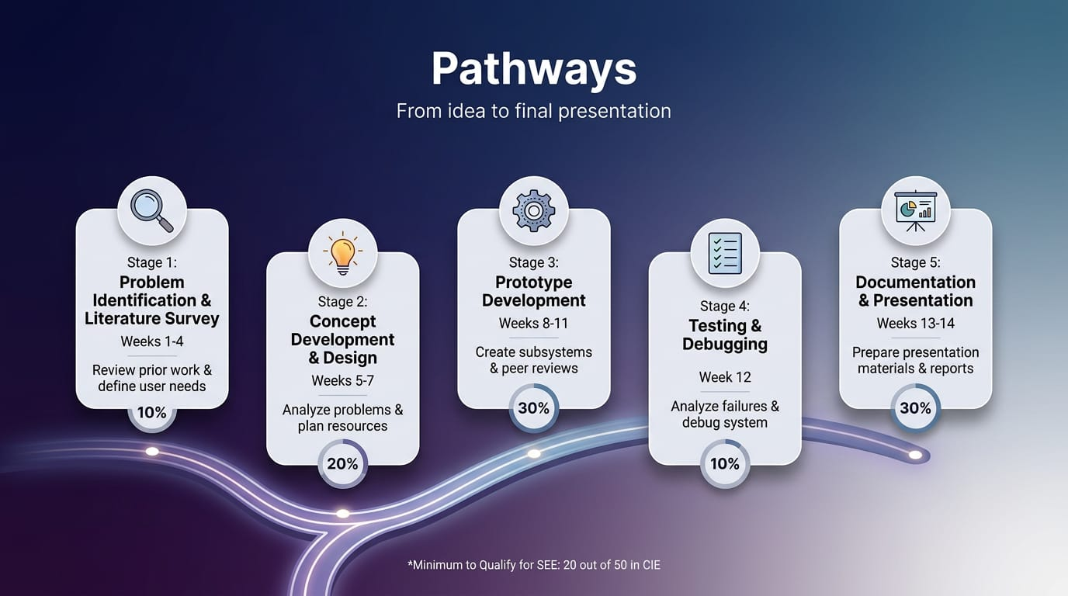

Slide 12
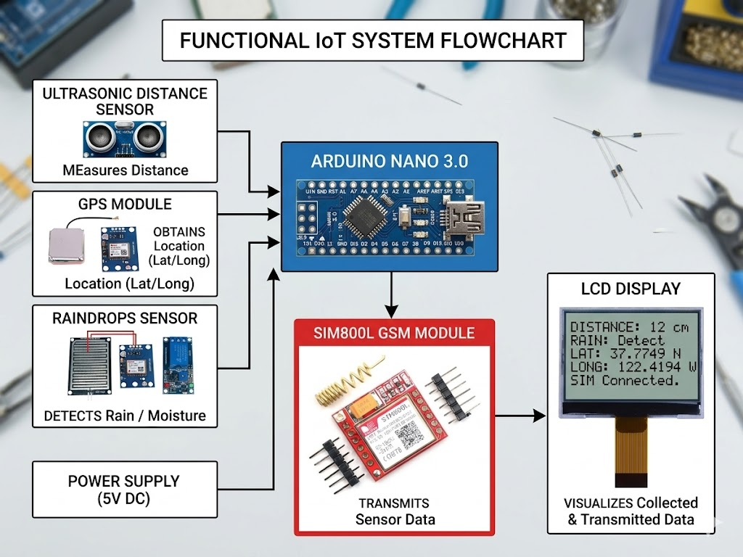

Slide 13
CONCLUSION :
The Smart Blind Stick represents a significant advancement in assistive technology for visually impaired individuals. It successfully integrates ultrasonic sensors, GPS, GSM, and water sensors into a single compact and lightweight device. The system provides real-time obstacle detection and audible alerts, greatly improving user safety during navigation. GPS and GSM modules enable accurate location tracking and emergency communication with trusted contacts. The Arduino Nano microcontroller efficiently processes all sensor data and ensures timely responses to detected hazards. The water sensor and remote localization feature add extra layers of safety and convenience for daily use. Overall, the Smart Blind Stick is a reliable, user-friendly, and transformative solution that empowers visually impaired individuals to navigate independently and confidently.

Slide 14
Thank You

